Slide 1



Department of CSE H
PROBABILITY STATISTICS AND QUEUING THEORY
22MT2005
Topic:
Continuous probability distributions
Session - 8
CREATED BY K. VICTOR BABU

Slide 2













AIM OF THE SESSION
To familiarize students with Uniform, Exponential distributions and its applications
INSTRUCTIONAL OBJECTIVES
This Session is designed to:
Demonstrate uniform and exponential distributions
Describe the applications of uniform and exponential distributions
List out the properties of uniform and discrete distribution
Solving problems of uniform and exponential distributions
LEARNING OUTCOMES
At the end of this session, you should be able to:
Define uniform, exponential distributions
Describe the properties and applications of Uniform and Exponential
Summarize the concepts with their applications

Slide 3
CO INTRODUCTION
CO2
Continuous Random Variables: Uniform, Exponential and Normal
Jointly Distributed Random Variables: Joint Distribution Functions, Independent Random Variables Statistics: Sample and population, Higher Order Moments, Variance, Standard Deviation, Measures of central tendency: Mean, Median, Mode, Measure of Dispersion: Variance, Standard deviation, coefficient of variation.
Correlation and Linear regressionRandom Variables, Probability Distribution Function - Cumulative Distribution Function

Slide 4

Uniform Distribution
One of the simplest continuous distributions in all of statistics is the continuous uniform distribution.
This distribution is characterized by a density function that is “flat” and thus the probability is uniform in a
closed interval, say [A, B].
Definition: The density function of the continuous uniform random variable X on the interval [A, B] is
1
^{= ቐ}B − A ,
A ≤ x ≤ B elsewhere
f x; A, B
0
Note: 1.
The density function forms a rectangle with base B-A and a constant height 1/ (B-A). As a result, the uniform distribution is often called the rectangular distribution.
. The probability is uniform in the interval [0,1] is said to be a standard uniform distribution.

Slide 5

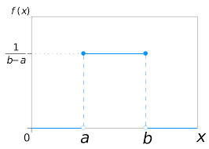
Unifrom distribution
source: https://en.wikipedia.org/wiki/Continuous_uniform_distribution
The mean and variance of the uniform distribution are
(𝐴 + 𝐵) (𝐵 − 𝐴)²
𝜇 =
𝑎𝑛𝑑 𝜎² =
2 12

Slide 6

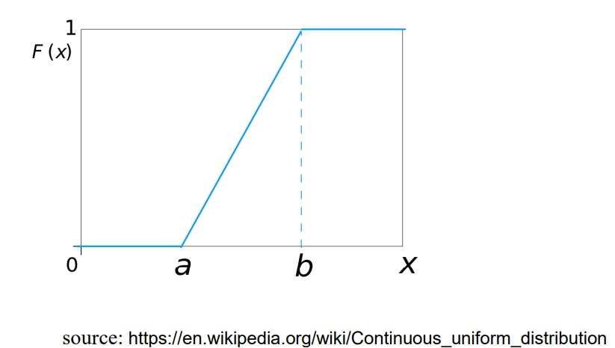
Unform distribution
The CDF, F(x), of a uniform random variable is shown below:
0
𝑥−𝑎
for x<a for x∈ 𝑎, 𝑏 for x>b
𝑏−𝑎
1
The graph of F(x) is shown below:

Slide 7


Exponential distribution
Exponential distribution plays an important role in both queuing theory and reliability. Time between arrivals at service facilities, and time to failure of components and electrical systems, often is nicely modeled by the exponential distribution.
Definition: The continuous random variable X has an Exponential distribution, with parameter β (β>0), if
its density function is given by
_{= ቊβ e}−βx
x > 0
f x, β
0 elsewhere
Note: 1) The mean and variance of the Exponential distribution are
μ = ¹ and σ ² = ¹ .
β
_{β} 2
Cumulative distribution function F(x) of the Exponential distribution is
β − failure rate

Slide 8

Exponential distribution
Memory less property of the exponential distribution:
The types of applications of the exponential distribution in reliability, and component or machine life time problems is influenced by the memory less or lack of memory property of the exponential distribution.
For example, in the case of, say, an electronic component where distribution of life time has an exponential
distribution, the probability that the component lasts, say t hours, that is
If X were the life of something, such as ‘how long this phone call to my mother will last’, the memoryless property says that after we have been talking for 5 minutes, the distribution of the remaining duration of the call is just the same as it was at the start. This is close to what happens in real life.

Slide 9

ACTIVITIES/ CASE STUDIES/ IMPORTANT FACTS RELATED TO THE SESSION
IMPORTANT FACTS
Rectangular distribution/ uniform distribution is constant function through the range of the random variable
Exponential distribution have the memory less property. It can uphold the present and
future or past and present in its memory.

Slide 10


EXAMPLE-Uniform
Example: A bus arrives every 20 minutes at a specified stop beginning at 6:40 A. M. And continuing until 8:40
A. M. A certain passenger does not know the schedule, but arrives randomly (uniformly distributed) between 7:00 A. M. and 7:30 A. M. every morning. What is the probability that the passenger waits more than 5 minutes for a bus?
Solution: The passenger has to wait more than 5 minutes only if the arrival time is between 7:00 A. M. And 7: 15 A. M. or between 7:20 A. M. And 7:30 A.M. If X is a random variable that denotes the number of minutes past 7:00 A. M. That the passenger arrives, the desired probability is P(0<X<15)+P(20<X<30)
Now, X is a uniform random variable on (0,30). Therefore, the desired probability is given by F(15)+F(30)-F(20)=(15/30)+1-(20/30)=5/6.

Slide 11

EXAMPLE-Exponential
At a receiving dock on an average 3 trucks arrive per hour to be unloaded at a warehouse. What are the probabilities that the time between the arrivals of successive trucks will be
a) less than 5 minutes b) at least 45 minutes c) is between 5 to 30 minutes
Solution: Assuming that the arrivals follow Poisson process, time interval between successive arrivals has an exponential distribution with mean 1/3 hours.
∴ Parameter of the exponential distribution β=3 The probability density is f(x)=3e^{-3x}
a) P(inter arrival time is less than 5 minutes)=P( inter arrival time is less than 1/12 hours)
1/12
= න 3e^{−3x} = 1 − e^{−1/4} = 0.221
0

Slide 12
EXAMPLE-Exponential
b) P(inter arrival time is at least 45 minutes)=P(inter arrival time is at least ¾ hours)
∞
= න 3e^{−3x} = e^{−9/4} = 0.105
3/4
c) P( inter arrival time is between 5 to 30 minutes)
1/2
3
= න 3e = e = −[e 2 − e
₋₃ 1/12
1/12
_{−3x} 1/2
₋3
3
−
−3x
12]

Slide 13


SUMMARY
In this session, the concepts of uniform and exponential distribution have described
Define Uniform distribution and its properties
Define Exponential distribution and its properties
Applications of Uniform
Applications of Exponential

Slide 14








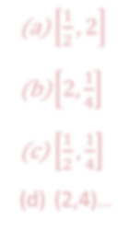
SELF-ASSESSMENT QUESTIONS
A random variable has uniform distribution over the interval [-1,3]. This distribution has variance equal to:
(a) 8/5
(b) 4/3
(c) 13/4
(d) 9/2
For an exponential distribution with probability density function
1
2
₋x
f x =
2;
e x ≥ 0,
its mean and variance are:
(a) ¹ , 2
2
(b) 2, ¹
4
(c)
1 , 1
2 4
(d) (2,4)…

Slide 15

TERMINAL QUESTIONS
Describe the memory less property of exponential distribution
Suppose that a large conference room for a certain company can be reserved for no more than 4 hours. However, the use of the conference room is such that both long and short conferences occur quite often. In fact, it can be assumed that length X of a conferences has a uniform distribution on the interval [0, 4].
What is the probability density function?
What is the probability that any given conference lasts at least 3 hours?
3. Suppose that a study of a certain computer system reveals that the response time, in seconds, has an
exponential distribution with a mean of 3 seconds.¹
𝛽
What is the probability that response time exceeds 5 seconds?
What is the probability that response time is less than 10 seconds?
What are the mean and variance of response time?

Slide 16
TERMINAL QUESTIONS
4. The density function of the time Z in minutes between calls to an electrical supply store is given by
1
₋ 𝑧
𝑓 𝑍 = ቐ
10 ^{𝑒}
10
,
0 < 𝑧 < ∞
0, 𝑒𝑙𝑠𝑒𝑤ℎ𝑒𝑟𝑒
Estimate the mean and variance of time between calls?
Estimate the probability that the time between calls exceeds the mean?
Estimate the probability that the time between calls is less than 5 minutes?
5. The daily amount of coffee, in liters, is dispensed by a machine located in an airport lobby is a random variable ‘X’ having a continuous uniform distribution with A=7 and B=10. Obtain the probability that on a given day the amount of coffee dispensed by this machine will be
at most 8.8 liters
more than 7.4 liters but less than 9.5 liters
At least 8.5 liters

Slide 17

REFERENCES FOR FURTHER LEARNING OF THE SESSION
Reference Books:
Chapter 1 of TP1: William Feller, An Introduction to Probability Theory and Its Applications: Volume 1, Third Edition, 1968 by John Wiley & Sons,Inc.
Richard A Johnson, Miller& Freund’s Probability and statistics for Engineers, PHI, New Delhi, 11th Edition
(2011).
Sites and Web links:
Continuous Random Variables and their Distributions (probabilitycourse.com)
Notes: sections 1 to 1.3 of http://www.statslab.cam.ac.uk/~rrw1/prob/prob-weber.pdf
3. Section 3.1.1 of TS1: Alex Tsun, Probability & Statistics with Applications to Computing
(Available at: http://www.alextsun.com/files/Prob_Stat_for_CS_Book.pdf)
Video: https://www.youtube.com/watch?v=- 5sOBWV0qH8&list=PLeB45KifGiuHesi4PALNZSYZFhViVGQJK&index=19

Slide 18


THANK YOU
Team – PSQT EVEN SEMESTER 2023-24

